Slide 1
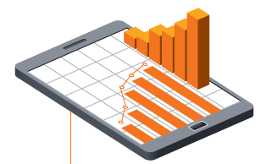
Why choose it’seeze
By Stephen Sibbit, it’seeze websites Watford
Office: 01923 269 800
Mobile: 07566 203 387
stephen.sibbit@itseeze.co.uk
www.itseeze-watford.co.uk

Slide 2
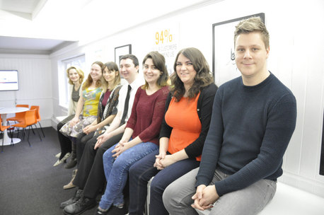
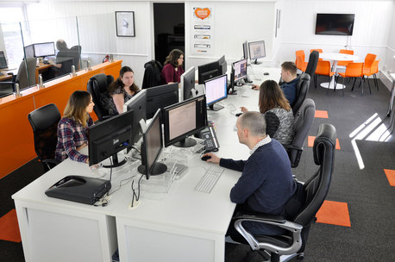
Who we are?
National company, local expertise
Making websites since 2003
Over 5000 sites created and growing everyday
Local, face-to-face, jargon free, advice
UK based Head Office,
Approaching 30 staff
In-house Designers and Developers
Help desk

Slide 3
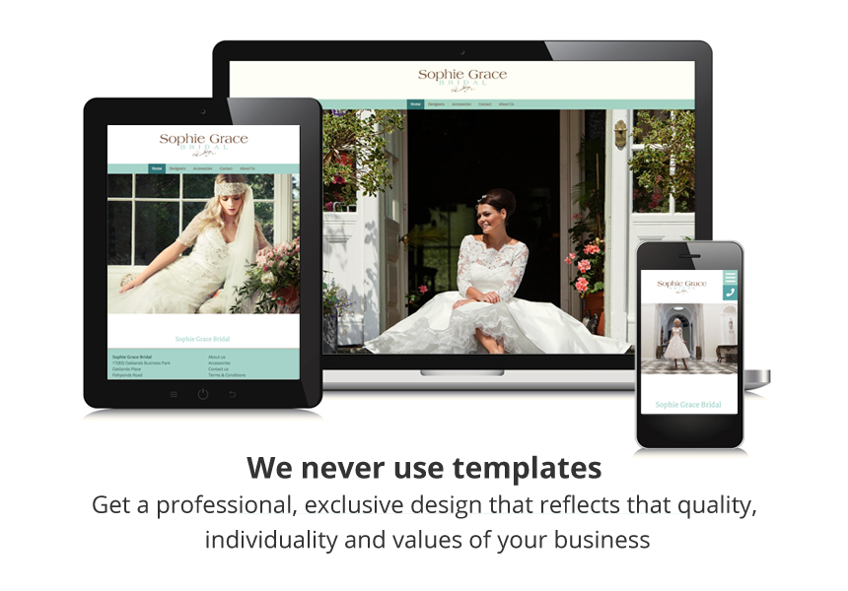
Why work with us
Me:
Local to you
Listen, advise, demonstrate, train
Project management
Our Websites:
Professionally designed - (no templates)
Choice of three website packages
Easy to use website editor
Affordable and value for money – no hidden costs
Our team approach/ongoing back up support:
Specialists
Experience and expertise across all sectors

Slide 4
Go to itseeze-watford.co.uk
You’ll find
Examples of our work from different industries
Testimonials
More about responsive technology
Website health check
And so much more . . .

Slide 5
Comprehensive aftercare
For the lifetime of your website
Me
Expert team at office
24/7 Support Website

Slide 6
Before and after examples of our work
Client wanted a newly designed website that reflected their new logo and brand image.

Slide 7
Before and after examples of our work
Wanted a website that was more modern looking and professional to better reflect the service they offer

Slide 8
Before and after examples of our work
Wanted a website that was easy to navigate and view on a mobile phone as most their traffic was coming from mobile devices

Slide 9
Before and after examples of our work
Wanted a website that was more professionally designed and easy to edit as they wanted to upload images and information about new projects they’ve undertaken

Slide 10
Before and after examples of our work
Wanted a fully responsive website that was much easier to navigate as well as being easy to edit and update

Slide 11
Website Packages
Five pages that work on mobile, tablet and desktop
£20*/month
£200* upfront
Versatile, expandable, comprehensive. With unlimited pages
£40*/month
£400* upfront
Unlimited pages. Secure payments
£50*/month
£500* upfront
* +VAT

Slide 12
What I’d ask of you
A good referral:
established business
already has a website
wants it to look more professional
be mobile-friendly
easy to update
wants to work with a local expert
Listen out for:
“My site needs updating but designers gone awol”
“Know any good designers?”
“My site is not effective- no enquiries”

Slide 13
Any Questions?
Thank you for listening
Call Stephen on 01923 269800
or email stephen.sibbit@itseeze.co.uk

