Slide 1
Ann Naylor Tel: 01753 201204
ann.naylor@itseeze.co.uk
itseeze-windsor.co.uk

Slide 2
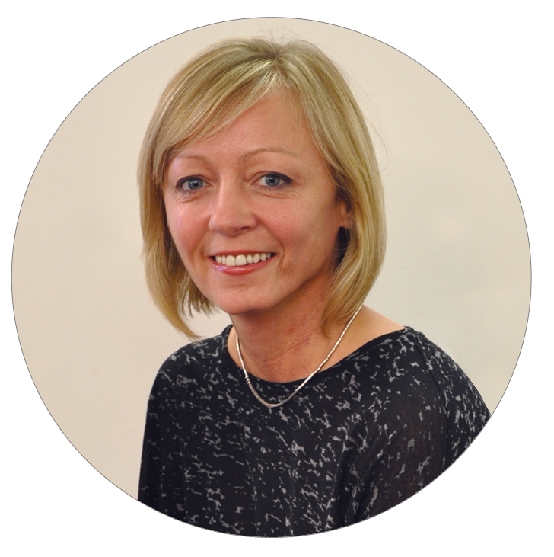
About Me
Over 10 years experience in Digital Marketing
Key focus on websites & SEO
Set up it’seeze Windsor in 2013
Approx 150 clients around the local area
Experienced end user of various tools to monitor performance of digital marketing

Slide 3
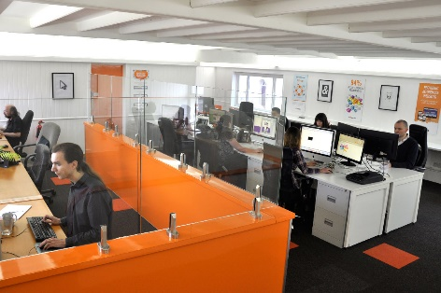
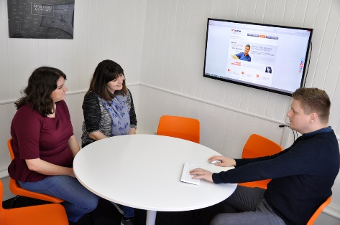
Who are it’seeze?
National web design company since 2003
Custom built Content Management System
Franchised in 2008
Design studio based in Torquay, Devon
15 highly experienced web designers & web developers
Approx. 40 regional offices across the UK and Ireland

Slide 4
it’seeze Windsor services offered. . .
Responsive Web Design
Social Media Branding
Search Engine Optimisation
Google Analytics
Email Marketing
Custom Google Analytics dashboards
Free web audits on existing websites
G

Slide 5
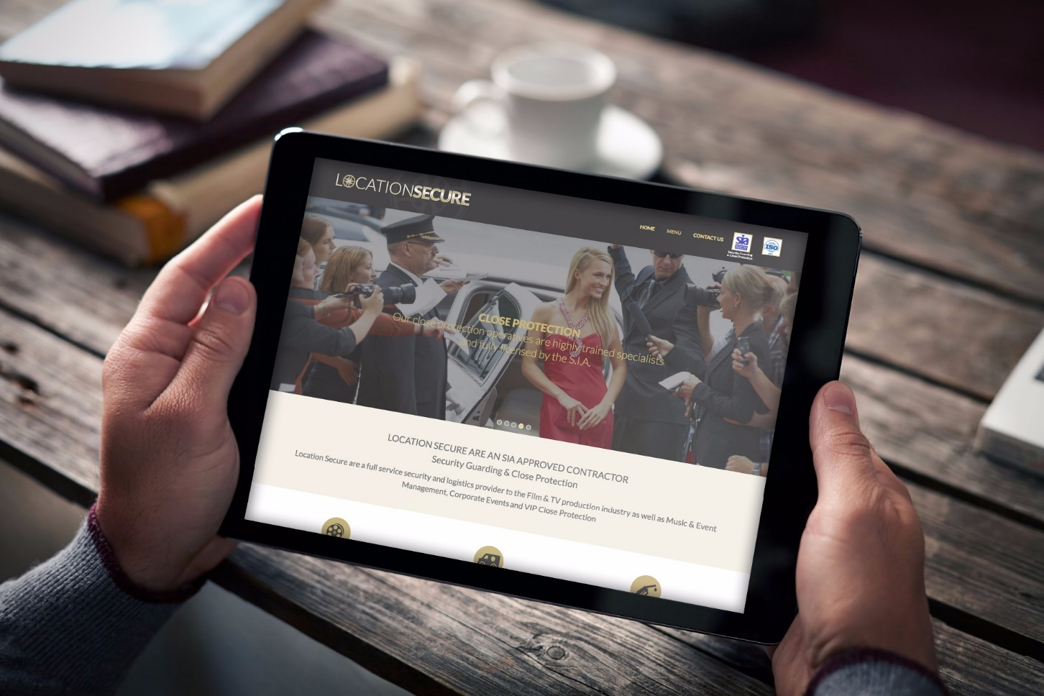
Key features of an it’seeze website
Bespoke custom design – no templates
Affordable payment plans
Local support
Powered by an easy to use CMS
Automatic updates to CMS
Built using latest technology
Websites quick to load
Lots of built-in features

Slide 6
WEBSITE PACKAGES

Slide 7
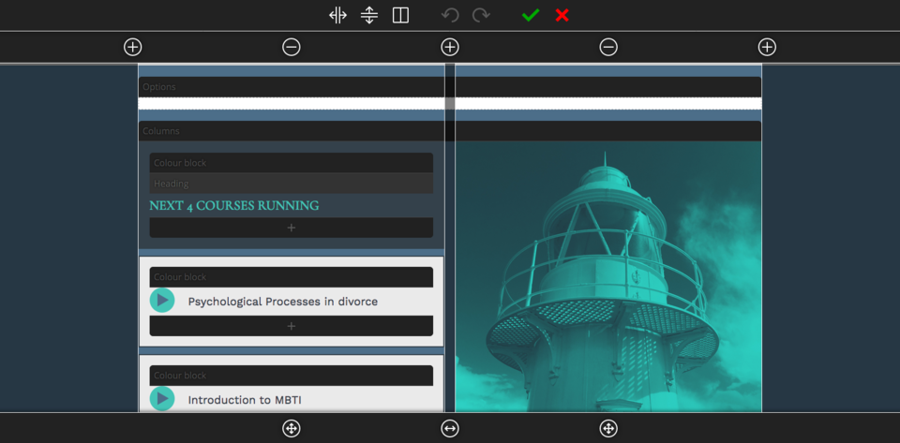
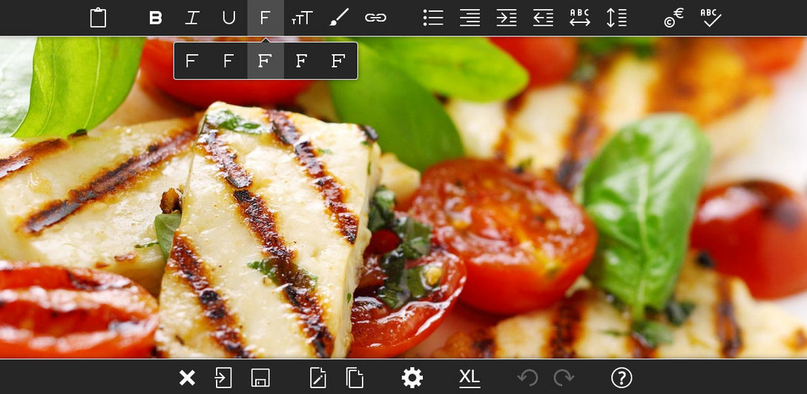
The it’seeze editing system
Our Editing System - Investment to date
10 years of development
130,000 lines of code
Security Features
Web-based interface with no direct server access for third parties
All files uploaded by clients scanned for viruses
All visitor-supplied content scanned for viruses and run through Akismet spam checker

Slide 8
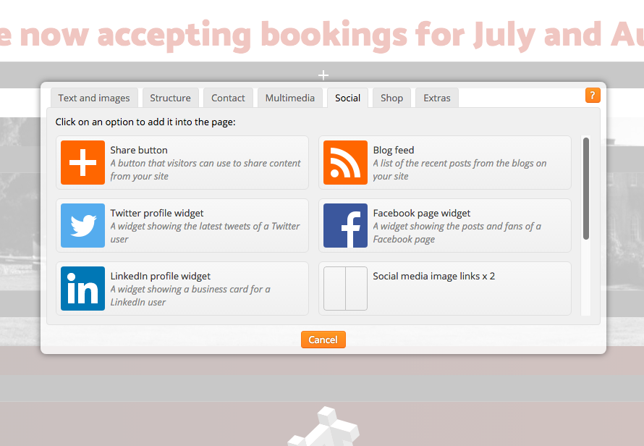
The it’seeze editing system
Hosted on dedicated servers – daily backups
Databases and files replicated continuously to back-up servers in Manchester and York
Off-site back-ups taken every 24 hours
Latest CMS upgrades, during 2016 & 2017
Built-in blog
New, highly-configurable shop product page layout
Integration with Tidio Chat
New payment gateways: Global Iris and Barclaycard ePDQ

Slide 9
What’s included in our websites
Custom built design
Content Management System
CMS Training
Local support
Online support 24/7
Domain name & management
Website hosting
Daily back ups of client sites
IMAP email addresses
Ability to easily add videos and audio
Ability to add password protected areas
Ability to integrate social media platforms
Blogging software
Tidio Live Chat
Submission to search engines
Google Analytics
Access to built-in SEO Tools

Slide 10
Who do I work with?
Start up companies
Sole traders
Small/medium sized businesses
Charities
HOW I HELP:
FREE INITIAL CONSULTATION
Free site audit on existing site
Review site structure
Design brief
Content planning

Slide 11
Far Red
Full Width Imagery

Slide 12
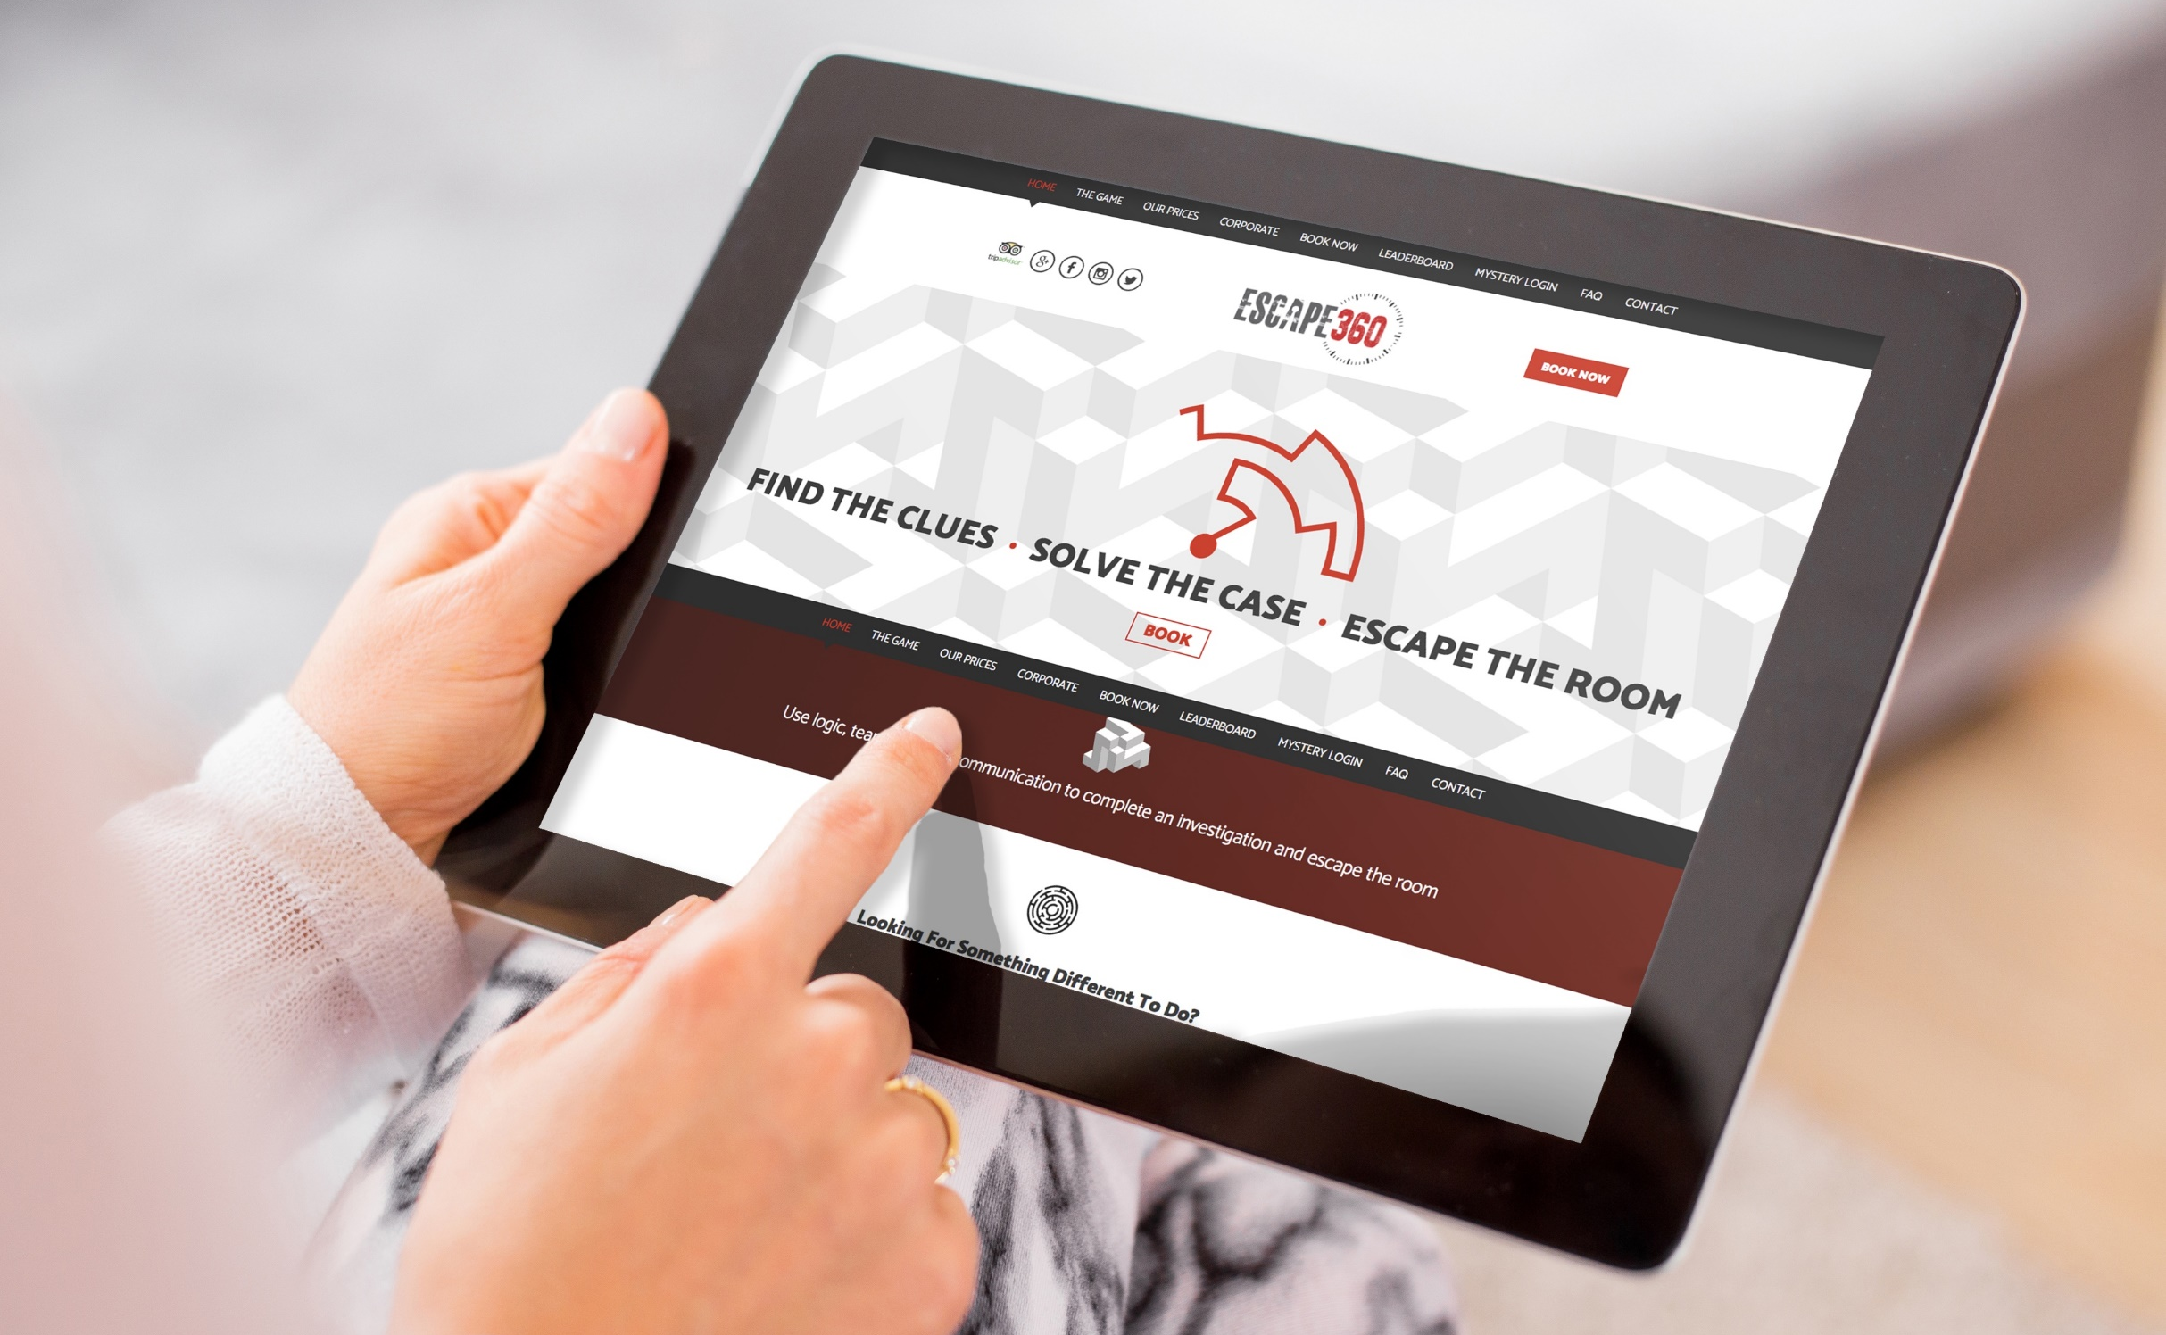
Escape 360
Icon Animation

Slide 13
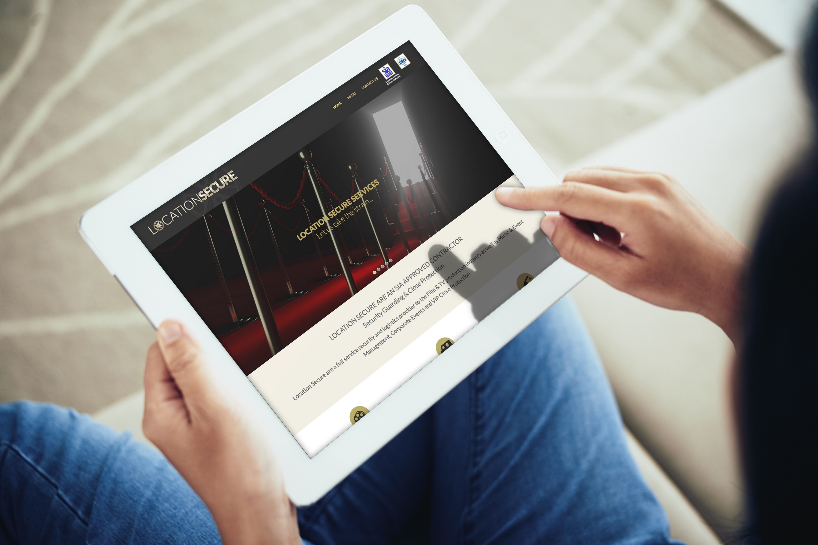
Location Secure
Logo Animation

Slide 14
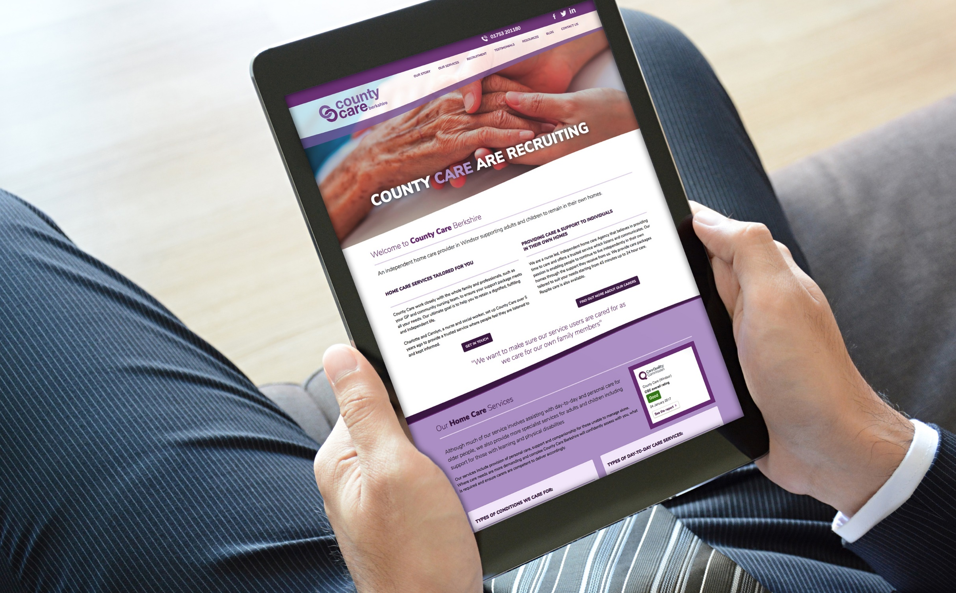
County Care Berkshire
Full Width Content

Slide 15
Nest Home Care
Split Columns

Slide 16
Stealth
Logo Colour Change & Animated
Content

Slide 17
CLIENTS

Slide 18
Web Design Trends for 2017/2018
Increase in responsive design
Google now ranking these websites higher in search results
Minimalism
Minimalist approach emphasising quality over quantity
Original photography
Brands will move away from stock imagery as a way to
promote their products and services
Creative typography
Dramatic use of typography is sure to be a
strong focus of web design in 2018

Slide 19
it’seeze websites
Brilliant Designs – Better results: Professionally designed websites that look great on any device

Slide 20
Any Questions?
Thank you for listening
www.itseeze-windsor.co.uk

