Slide 1
Getting your business ready for the mobile revolution
By Joe Bloggs, it’seeze somewhere
Te: 01234 567 890 / 07712 345 678 email address here
itseeze-somewhere.co.uk

Slide 2
Did you know . . .
38 million smart phone users in the UK alone
80% of adults use their mobile phone to browse the internet
If you website doesn’t load in less than 3 seconds then 40%* people will just abandon it
60%* of people won’t stay on your site if it’s not mobile-friendly
67%* of people are more likely to buy a product or use a service from a website that is mobile friendly
Google ranks mobile friendly websites above non-mobile friendly websites
*Google

Slide 3
Take the test
View your website on a mobile phone
How quickly does it load?
Do you to pinch the screen or scroll horizontally?
Where does you business appear on Google?

Slide 4
Is mobile-friendly the same as responsive?
A responsive website is a single site that works across all devices.
The term “mobile-friendly” is a very broad term that also includes other solutions such as having a separate mobile site.

Slide 5
What is a ‘responsive’ website?
One website that looks great on a mobile, tablet and desktop.
As easy to use on a mobile as on tablet and desktop -
No pinching or squinting
When viewed on smaller screens the design switches to become narrower with larger links and likewise it expands when viewed on larger screens.

Slide 6
Benefits of responsive vs mobile website
Just one site to:
optimise for search engines
build links, social shares and traffic (has SEO benefit)
set up Pay Per Click campaigns for
monitor statistics

Slide 7
Benefits of responsive vs mobile website
Loads faster than mobile specific sites
Easier and quicker to edit:
Make changes once and they show on any device
Vary the content depending on the device it’s viewed on.
Content automatically and optimally reformats and rescales.
Preview changes in mobile and desktop format

Slide 8
Benefits of responsive:
Generate more traffic – being found on a mobile device
Reduce abandoned check outs
Boost customer engagement
Boost number of returning visitors
Give an edge over competition – 4% sites currently responsive
Increase sales
Save time
Save money
Improve SEO

Slide 9
Advice: Be careful . . .
!
Many website companies claim to offer fully responsive websites but they are flawed
Examples...

Slide 10
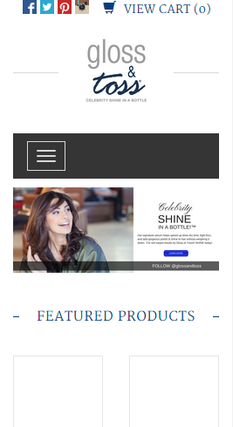
GoDaddy: glossandtoss.net
Social media icons too small to press on a touch screen mobile
Text that is legible on a desktop, is not legible on a hand held device

Slide 11
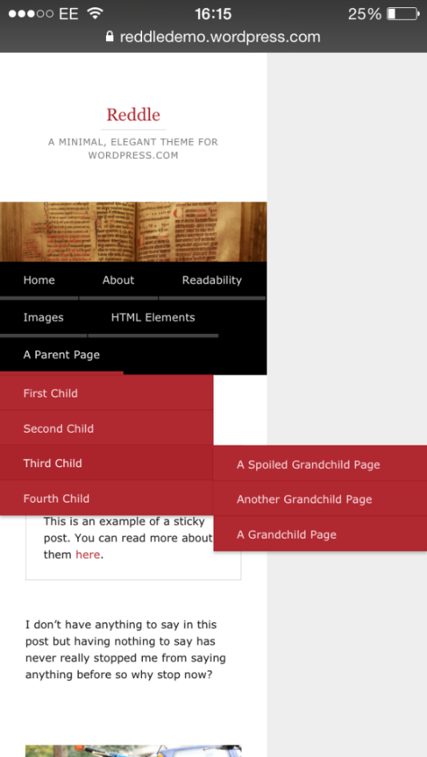
WordPress: reddledemo.wordpress.com
To display a ‘grandchild’ page, the sites halves in size to fit this on the screen

Slide 12
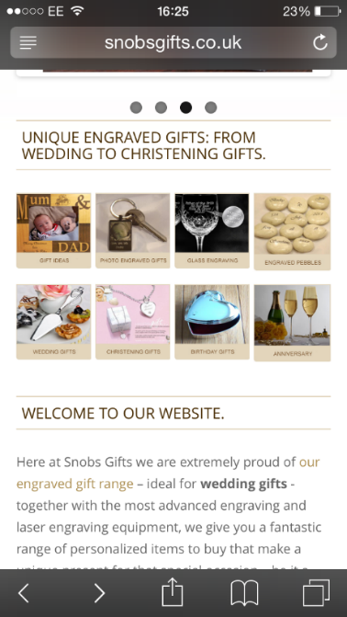
Site Wizard: snobgifts.co.uk
Facebook widget does not adapt on tablets and mobiles
Text on category images is too small to easily read on a mobile

Slide 13
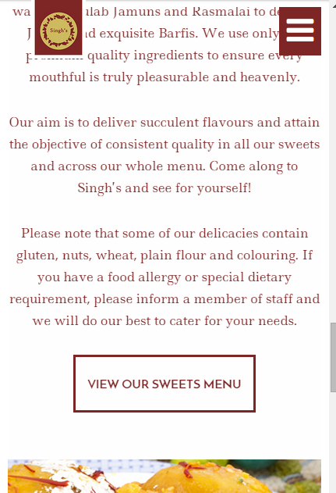
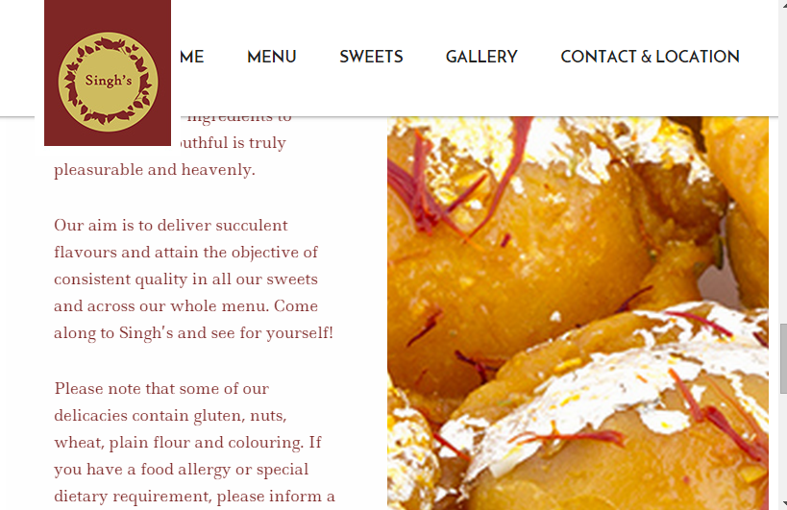
Site Wizard: singhsgravesend.com
On a tablet device the logo overlaps the content
On a mobile device the logo and the menu overlaps the content

Slide 14
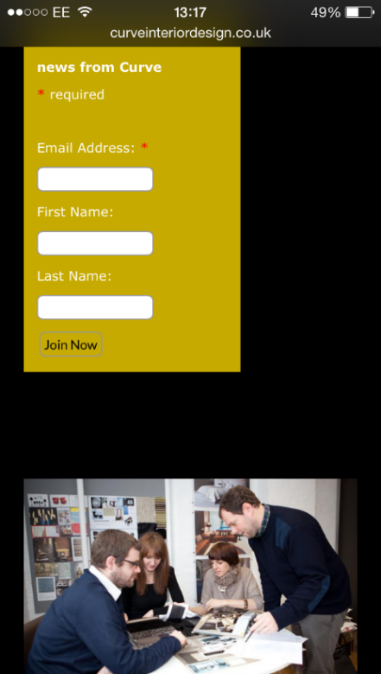
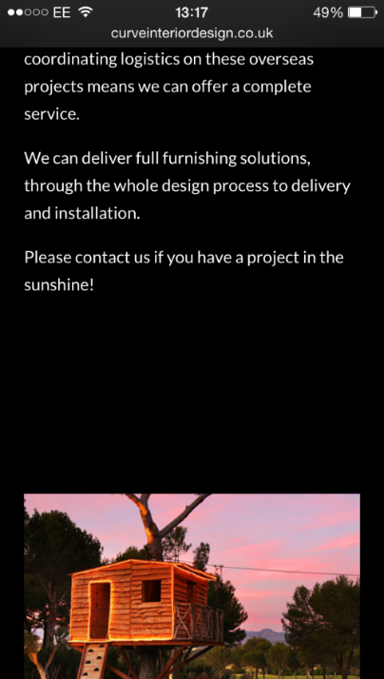
Nettl: curveinteriordesign.co.uk
Small fields makes form hard to fill in on mobile
Text on this page not responding to mobile screen size.
Unnecessary blank spaces means more scrolling is required

Slide 15
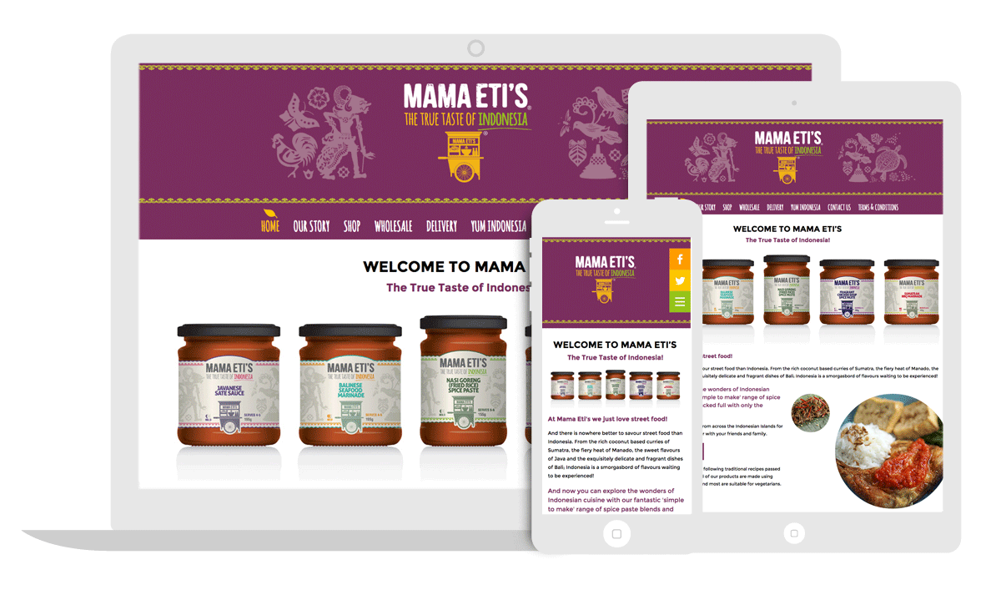
Why choose it’seeze:
Brilliant Designs: Professionally designed websites that look great on any device

Slide 16
Why choose it’seeze:
Easy to view: Display perfectly, even on a mobile so no there’s no pinching or squinting.

Slide 17
Why choose it’seeze:
Fully functioning: Videos, Google Maps and Social Media feeds work seamlessly.

Slide 18
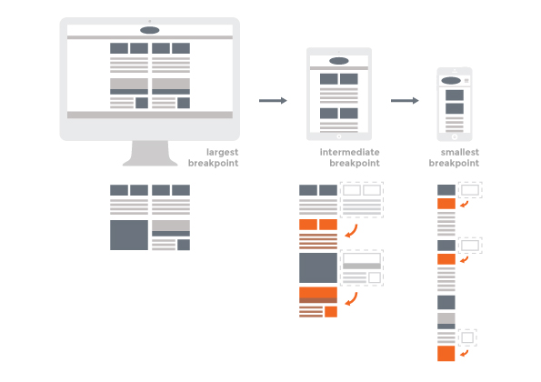
Why choose it’seeze:
Edit within break points: Allowing the amount of content on smaller devices to be reduced if necessary.

Slide 19
A short video

Slide 20
Any Questions?
Thank you for listening
By Joe Bloggs, it’seeze somewhere
Te: 01234 567 890 / 07712 345 678 email address here
itseeze-somewhere.co.uk

