Slide 1
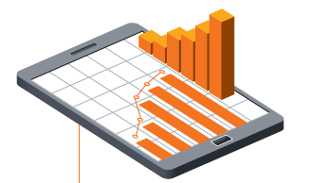
10 easy steps to improve your online business performance
By Rob Davies, it’seeze websites Ryedale
Office: 01653 690 982
Mobile: 07957 374 787
rob.davies@itseeze.co.uk
www.itseeze-ryedale.co.uk

Slide 2
Ask yourself . . .
Could your website be performing better?
Would you like more web traffic?
Do you want your website to start delivering real returns?

Slide 3
YES
!
It’s not as hard as you might think
Here are 10 easy ways to boost the performance of your business

Slide 4
1. Include your URL everywhere
Stationery
Leaflets
Adverts (both printed and online)
Business Cards

Slide 5
2. Submit your sitemap
Easier for Google to categorise your website
Boost your ranking and visibility online
More visits to your website
TIP: Add sitemap from Google Search Console

Slide 6
3. Set up Google My Business
Free and easy to do
Boosts visibility on local search including Google Maps

Slide 7
4. Set up Google Analytics and Search Console
See useful information about people visiting your website:
Number of visits
How they’re finding your website
How long they’re spending on your site
Which pages they visit
USEFUL RESOURCES: Analytics Academy with Google and Google Search Console

Slide 8
5. Get backlinks to your website
Are you a member of trade associations?
Do you have any accreditations?
Get listed on their sites
Backlinks boost search rankings
More traffic to your website

Slide 9
6. Register on QUALITY directories
Yell.com
Thomson Local
DMOZ
Yahoo! Directory
About.com
Increases chance of being found online.

Slide 10
7. Make an email signature
Include name and contact details
Include website address and strapline

Slide 11
8. Update website content regularly
Frequently add fresh and interesting content:
Change a picture
Add a promotion
Write a blog post
And get rewarded by Google with higher search rankings
USEFUL RESOURCE: Read our blog about the ‘benefits of blogging’ on itseeze-ryedale.co.uk

Slide 12
9. Start an e-newsletter
Easy and cost effective way to promote your business:
Share company news
Promote offers, new products
Build brand credibility with tips
Drive more traffic to your website

Slide 13
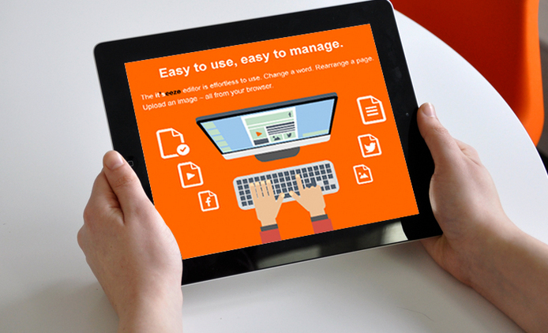
10. Make sure your website is up to scratch
First impressions count
It’seeze Ryedale can help:
Professionally designed
Easy to edit
Mobile friendly
Affordable
And me!

Slide 14
Any Questions?
Thank you for listening
Call Rob on 01653 690 982
or email rob.davies@itseeze.co.uk
Download our free ‘Guide to Marketing’

