Slide 1
Packages and Pricing Plans

Slide 2
Session Topics
Packages and pricing plan
Upgrades and downgrades
Extras
Oscar Akiki
Finance Director

Slide 3
Packages
it’seeze Lite
it’seeze Max
it’seeze Commerce

Slide 4
Pricing plans
Lite – 24 months
Price plan - £20/mth
Upfront - £200
Max – 12 months
Price plan - £40/mth
Upfront - £400
Commerce – 12 months
Price plan - £50/mth
Upfront - £500
The total cost of the Lite price plan for the minimum term is the same as the Max plan – just without the features
All prices are subject to 20% VAT

Slide 5
What’s my commission?
Lite
Price plan - £10/mth
Upfront - £150
Upfront in first 12 months - £200
You receive 100%
of the upfront payment
in the first 12 months
Max
Price plan - £20/mth
Upfront - £300
Upfront in first 12 months - £400
Commerce
Price plan - £25/mth
Upfront - £400
Upfront in first 12 months - £500
All prices are subject to 20% VAT

Slide 6
Upgrades: the prices
Responsive to responsive
To Max
New payment plan - £40/mth
Upgrade payment - £0
You receive 100%
of the
upgrade payment
To Commerce
New payment plan - £50/mth
Upgrade payment - £100
All prices are subject to 20% VAT

Slide 7
Upgrades with new design
non-responsive to responsive
To Lite
New payment plan - £20/mth
Upgrade payment - £150
Your upfront commission - £100
Upgrade includes a population of 5/10 pages
* Additional pages are £35 per page, if they exist on the current website
To Max *
New payment plan - £40/mth
Upgrade payment - £300
Your upfront commission - £200
To Commerce *
New payment plan - £50/mth
Upgrade payment - £300
Your upfront commission - £200
All prices are subject to 20% VAT

Slide 8
Upgrades with same design
non-responsive to responsive
To Lite
New payment plan - £20/mth
Upgrade payment - £100
Your upfront commission - £50
Upgrade includes a population of 5/10 pages
* Additional pages are £25 per page
To Max *
New payment plan - £40/mth
Upgrade payment - £150
Your upfront commission - £100
To Commerce *
New payment plan - £50/mth
Upgrade payment - £150
Your upfront commission - £100
All prices are subject to 20% VAT

Slide 9
Upgrades: Contract Lengths
A new minimum term is started upon all upgrades.
The minimum term is that of the new upgraded package.
EXCEPTION: when upgrading from the Lite package within the first 12 months, the Lite minimum term will remain.

Slide 10
Downgrades
There is no downgrade payment.
This is used to retain customers who would otherwise cancel.
The customer does not enter into a new minimum term.
A downgrade is only possible if the minimum term is completed.
To Max: New payment plan - £40/mth
To Lite: New payment plan - £20/mth
An email must be sent to finance@itseeze.com
to request a downgrade
All prices are subject to 20% VAT

Slide 11
Extras
Custom Features
Standard Features

Slide 12
Extras: Custom Features
External website integration
We offer bespoke functionality that is not a standard part of the it’seeze website editor.
Custom features are not available on the it’seeze Lite price package.
Commission is based on a sliding scale structure.
For a quote, please email: development@itseeze.com
Property databases
Quote engine
JavaScript animation
Social media branding
Booking forms

Slide 13
Custom features: Sliding scale
10%
15%
20%
25%
£250
£1000
£2000
>£2000

Slide 14
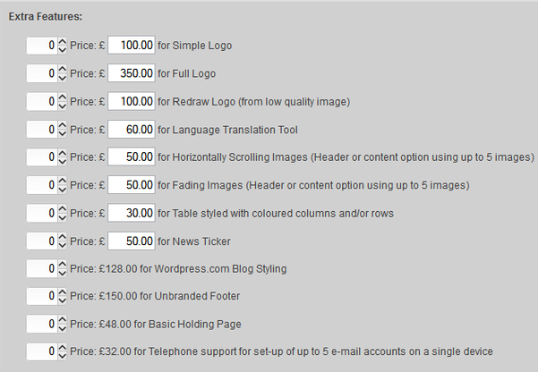
Extras: Standard Features
We offer additional functionality, which is regularly requested by the customer.
These features are built into the Admin System with fixed prices.
The customer is charged between the minimum and maximum price.
You receive the difference between the price the customer pays and
the minimum price

Slide 15
Any questions
All training material
and more resources
are available on the
it’seeze Support website

