Slide 1
Marketing Features and Benefits

Slide 2
Why people choose it’seeze?

Slide 3
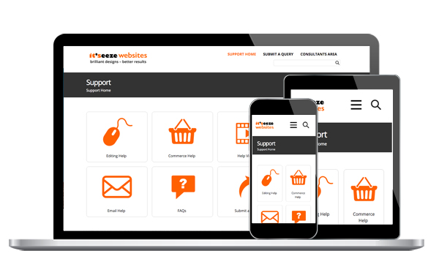
We offer ongoing, total support
Useful marketing tool:
‘Our Work’
http://support.itseeze.com/
You!
No call centres
Ongoing support – even after website is live
Support team at UK Head Office
Technical assistance
Support cover if you are absent
24/7 Online Support Centre

Slide 4
We know what we’re doing
Useful marketing tool:
‘Our Work’
http://itseeze.com/our-work/
Showcases broad range of examples and testimonials and case studies
Creating websites since 2003
Been a franchise since 2008
Created over 5,000 websites – for types of businesses
Qualified, skilled, and experienced team

Slide 5
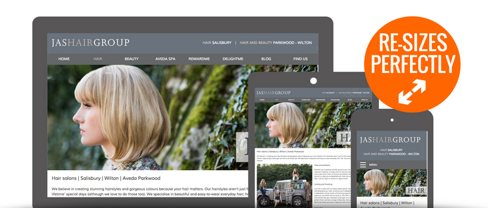
We create professional, unique, responsive designs
Useful marketing tools:
Page explaining about responsive : http://itseeze.com/what-is-responsive/
Video explaining responsive:
https://www.youtube.com/watch?v=iNOOjWbfCDo
‘Our Work’
http://itseeze.com/our-work/
Your leaflet: Websites that work on every screen
Before and after examples:
COMING SOON
Every site is custom created by a qualified, experienced designer
Never use templates – all custom designed
All our websites look great and are easy to navigate on any device.
No pinching
No zooming

Slide 6
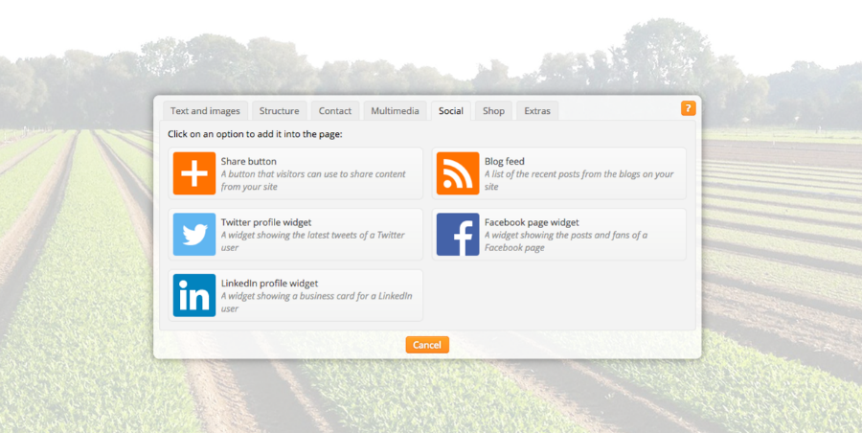
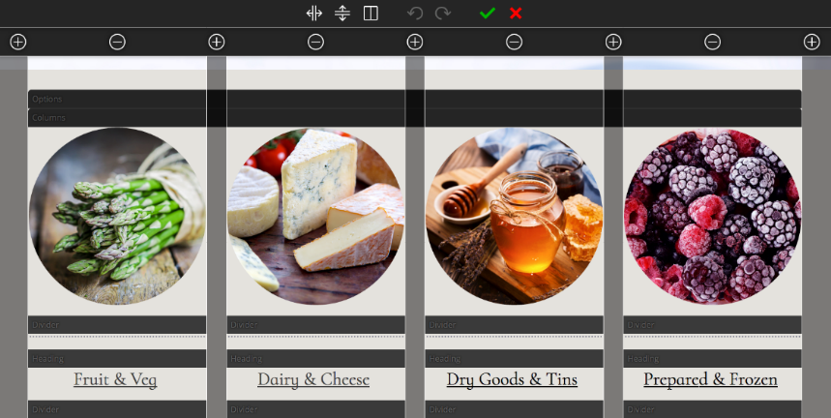
Our website editor is incredibly easy to use
Easy to use – no hassle
Works in any modern browser – no software required
The end user is in control – real-time, unlimited editing
Change a picture. Switch a promotion. Add a few words, or a new page.
Free updates – new tools and components added regularly
Useful marketing tools:
Page explaining about the editor:
COMING SOON
Video teaser showing the editor:
COMING SOON
‘How to’ video bank on it’seeze YouTube channel:
https://www.youtube.com/watch?v=rjBO2iqyM9s&list=PLdGfwZxdnAchVo6uBcnZYPGI0qHFK8D6o

Slide 7
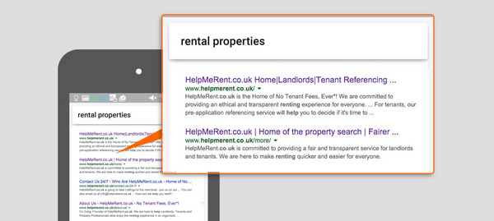
Our websites get found in search engines
Google favours:
Mobile friendly websites
Websites that are frequently updated
Head Office submits every site to search engines and ensures every page has unique title and description
Access to easy to use, built-in SEO tools
Add metadata – from alt text to page descriptions
Useful marketing tools:
Video showing how to SEO site:
https://www.youtube.com/watch?v=ViL1EUbEOgk

Slide 8
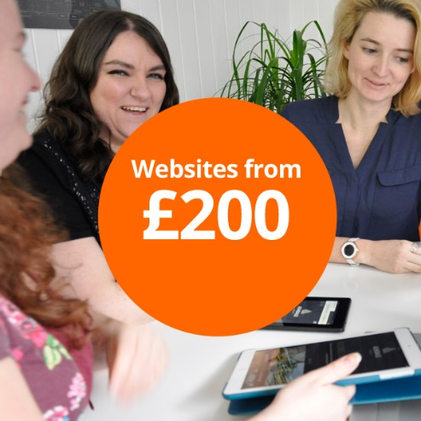
Our pricing plans make professional websites affordable
Useful marketing tools:
Your leaflet: Powerful websites for every business
Pricing page http://itseeze.com/prices/
‘Why Pay Monthly?’ document
COMING SOON
Choice of three packages
Really simple – perfect for small business
Full control – grows with your business
The really easy online shop
A low set up fee - no expensive initial outlay
Monthly subscription - enables cash flow management and effective budgeting
All the essentials included
Up to 5 email addresses
Domain name
Hosting
No hidden costs

Slide 9
Our websites are feature-rich at no extra cost
Useful marketing tools:
Pricing page for all features http://itseeze.com/prices/
Go to package specific pages for more detailed benefits:
http://itseeze.com/prices/lite-package/
http://itseeze.com/prices/max-package/
http://itseeze.com/prices/commerce-package/
Key features:
Add a Google map with directions
Add social media links
Add social media feeds*
Add videos*
Add iframes – like Google Calendar and TripAdvisor*
Integrates with multiple payment options*
Works with Mailchimp
Add Tidio Chat*
Post blogs*
Password protect pages*
* Not available on Lite

Slide 10
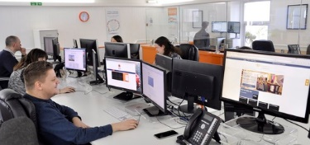
Our websites are secure and backed up
Websites are stored, backed up, and hosted in UK data centres

Slide 11
Why wouldn’t people choose it’seeze?

