Slide 1
Franchise Sales Training

Slide 2
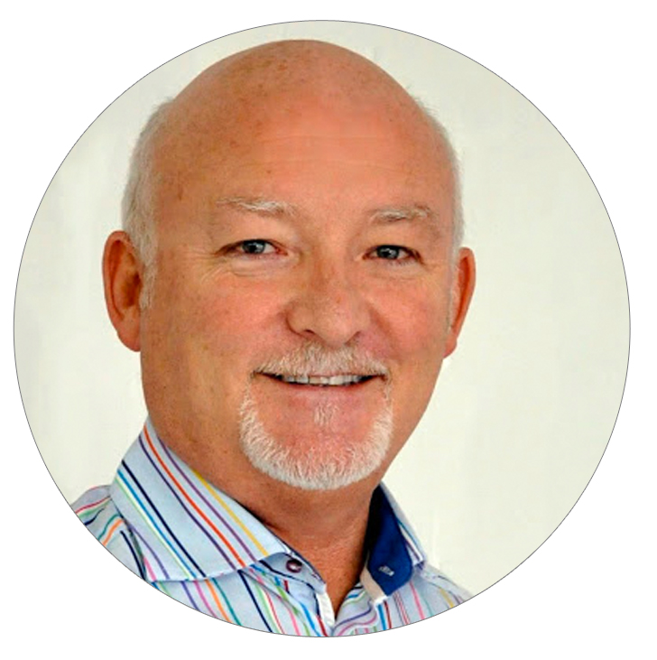
Session Topics
Sales funnel
Prospecting methods
Online presence
The sales process
Overcoming objections
General tips
Ian Burnett
it’seeze Warwick

Slide 3
Sales Funnel

Slide 4
Sales Funnel – traditional model
PROSPECTING
Awareness
Conversion
Loyalty
Engagement
Evaluation
Make people aware
Networking /Telemarketing/
Social Media /Other
Educate and demonstrate relevance
Networking / Telephone
Face to Face Cold Call
SALES PROCESS
Involvement and interaction
Networking 1:1 & Elevator Speech
Telephone Discussions
Face to Face Meetings
Purchase decision (closure)
Features & Benefits vs Competition
Payment
Timing
Convert and gain loyalty
Go Live
Training / Contact
Testimonials
Referrals

Slide 5
Prospecting Methods

Slide 6
Prospecting Methods
Networking
Telemarketing
Canvasing
Online networking

Slide 7
Networking
Focussed
Commitment
A wider sales team
One seat policy
Weekly
Comradery
Commitment - measured
Weekly
Territory restrictions to one group
Open door to many meetings
Flexible attendance
More relaxed
More relaxed less focussed
Many transients

Slide 8
60 secs (BNI) / 40 secs (4N)
Your confidence will grow.
Early on educate and demonstrate relevance. Write down and practise. I still have my first ever 4N speak in my folio!
Focus on one feature each 60s. e.g. responsive, bespoke, easy to edit, etc.
Do not repeat the same 60s/40s week in, week out. People will get bored quickly. Try and build a portfolio and us it depending on the profile of visitors in the room.
When you have some confidence have some fun!
stethoscope web doctor at BNI

Slide 9
Networking Hints
Don’t Worry ! Everyone is supportive
Practise your elevator speech - (example overleaf)
Identify quickly people you can work with to generate referrals
Graphic designers, copywriters, SEO, etc.
Don’t sell into the room – this is a big no-no!
Be patient – the referral curve can take a long time to get lift off. People will not refer or use your services until they have confidence and trust you. Just because you are a web designer they have plenty to chose!
Try to avoid talking about being a franchise. Build a brand and say backed up by head office and design and development team
Target your 1:1’s in 4N. Early days everyone will want to talk to you being the new guy!
Always follow up and do what you say you are going to do

Slide 10
Telemarketing Tips

Slide 11
Online Networking
LinkedIn
Some leads, and definitely worth investing time in as it supports connections to 4N and BNI
Need to build a local presence, and can be difficult to control where leads come from

Slide 12
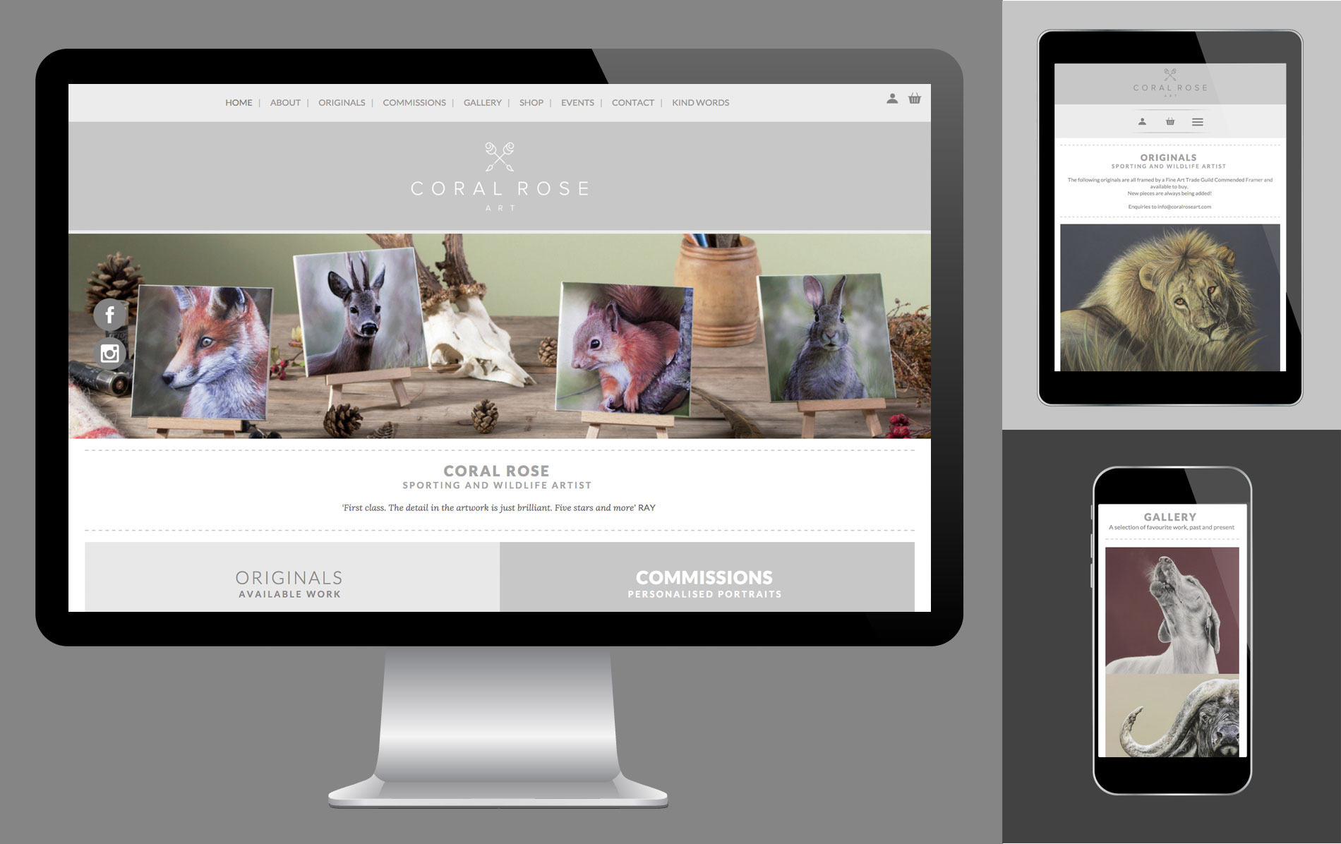
Online Presence

Slide 13
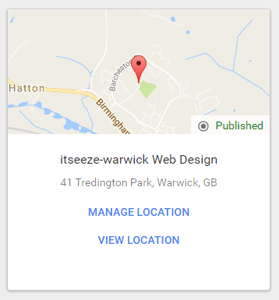
Online Presence
Web Site launch
Follow up ( 1 x sale achieved – with repeat opportunities)
It’s a potential lead and a great opportunity to practise
Generate your business visibility across the web
Get you business listed on website which will give your business visibility
Google Business etc.
Take time to get you description correct.
You may need to revisit when you are more experienced
and realize what your brand/USP is

Slide 14
The sales process

Slide 15
The Sales Process
Establishing a qualified lead
Securing an Appointment
Preparing for an appointment
The meeting
Closing techniques
Follow up
Site Live – training and more

Slide 16
1. Establishing a qualified lead
How?
Telesales – build on the telesales training during the training week. Refer to business plan tasks (covered on day 5).
Click throughs on franchise launch
Hints
Act quickly on any follow up. Get there before your competitor
Build a message for each type of contact type
Don’ t sell on the phone – find something that will trigger their attention. Ask questions and establish rapport

Slide 17
2. Securing an appointment
Don’t offer a solution over the phone
Don’t get into too much detail. Save it for the meeting.
Health check is a good starting point so run Sitebeam.
Try to find some other angles (e.g. targeting Webworks worked for me)
Be prepared to see you clients at the weekend and in the evenings. A lot of small businesses are too busy in the working day and if your offer flexibility then you will stand out.
Try not to come across as a salesperson in setting up the appointment. Come across as a person who cares for their business and wants to help them grow their business with a great website and get them to think you are the best at what you do! Try a couple of angles early days such as SEO (always a science and not many people really know much but its quick to learn the basics)

Slide 18
3. Preparing for an appointment
If existing website exists run a Sitebeam report (example – Lindy Allfrey)
Look at itseeze sites designed in the same sector
On your own site in the example section
Google “designed by itseeze “ and the sector , example “ restaurant designed by itseeze”
Create a folder in your browser so you can store the sites to favourites for this sector/prospect and you can quickly access the during the discussion
Think about custom designs that may be needed so you are prepared
Prepare an agenda
Think about looking at 123-reg to confirm ownership and registration of domains, or availability of potential domains. You can find sometimes some issues with registration which the domain owner is not aware of and this can help establish your credibility in the meeting.
Practise the Admin System just in case you get that first order! You must be competent on that first transaction!

Slide 19
4. The meeting
If I can, I ALWAYS start the meeting after the pleasantries with this phrase “ I don’t want to talk to you yet about your web site, I want to talk to you about your business and what your objectives are first. The website will naturally fold out of that”
Ask questions about the clients market, customers, growth areas, poor performing areas first. Then move onto “how do your clients or prospective clients find you?” This the time you find out the sweet spots:
SEO -Local presence on search for example
Talk about 60-70% of traffic to websites is via mobile/tablet a great opportunity for the responsive sell.
Ask about how much control of editing a great opportunity for the editing sell etc.
Aim to sell on your first visit, but don’t be disappointed if you don’t. Sometimes more is required, but my fastest was 43 minutes start to finish
If required, get an appointment for a follow up before you leave

Slide 20
5. Closing Techniques
At the end of the meeting ask the question. “what do you think”
Keep quiet!
If positive then say – lets get you on board now then. I need to create a customer ID for you and set up the payments, Initial and Subscription etc.
If negative/objections (see later!)
Timing
Find out when site is needed and work back from that to create pressure for a decision to start.
Don’t wait to close
Don’t need to talk abut the whole package. Just focus on what’s important to the client. E.g. if they don’t want to edit, then don’t spend too much time demonstrating the editing system!

Slide 21
6. Follow Up
Common sense approach
Keep to agreed timescales
Detailed letter to cover requirements and our offer (example to be linked)
Word the follow up with the presumption of a follow up contact
Be persistent
Use phone and email to follow up
Be prepared to meet up quickly to close and get the contract signed. Evening and weekends

Slide 22
7. Site Live and beyond
Training Website Editor – some do some don’t need it, but you need to train your customers. Don’t get bogged down having to make edit for your customers.
Email – take care it can be painful
Cover the basics of the Website Editor (covered on day 5)
Once live and all is well, then its testimonial time (for some!)
Build testimonials and ask for reviews for online networks e.g LinkedIn
Build relationships
I’m looking for FANS and DEVOTED FOLLOWERS as the referrals will eventually follow. Ask for them too.

Slide 23
Overcoming objections

Slide 24
Overcoming objections
Why must I start Paying Now
The service begins once payment is received.
We require a commitment to begin the setup and design of your website. You wouldn’t go to the shop and eat the product before purchase.
This is industry standard. Most digital services require payment before customers can benefit from the service.

Slide 25
Overcoming objections
What does my monthly fee cover?
It’s the most common objection. I use the following – all or in combinations as needed:
Our agreement is a subscription agreement, like you have with mobile phone contracts.
The cost of building a website is much more than the initial payment! We have a payment plan where we focus on the service and elements received within the package.
As above, focus on the packages elements to offer a ‘one-stop shop’ that includes things such as domains, emails, hosting, the Website Editor, advice, and more

Slide 26
Overcoming objections
I am talking to another web designer
Qualify them, are they a sole trader? If so then say that it’s likely they will disappear. it’seeze been around for over 10 years across the UK and have a proven track record
Lots are start-up design companies – it’s easy to get into web design using an off-the-shelf template but they don’t last
They are likely to be using many self-build template options. The sites will not appear professionally and uniquely designed and therefore don’t stand out from the competition! Show some examples of templates and compare to our work.

Slide 27
Overcoming objections
I need time to think about this
Establish timescales for launch and then try to get a decision based upon the need to move quickly

Slide 28
General tips for first 6 months

Slide 29
General tips for first 6 months
What has worked for me
Selecting a target competitor and search locally: ‘designed by Webworks’
Compare your competitors to it’seeze (often they will use the WordPress platform)
Adds credibility
Competitor analysis template on support site
Networking
Get some basic SEO knowledge
Be prepared to meet clients at the weekend and evenings
Develop a good working relationship with the Head Office Team. They are VERY supportive.
Follow business plan

Slide 30
General tips for first 6 months
Utilising methods / tools
Research WordPress
Have c 25% share of the open source CMS market. Likely to come across them. Good to know how we fair against their system. Used by a lot of one man bands.
Use CRM
Important to manage and measure your prospects and clients
Disciplined Telesales
Establish a plan and try to keep to it
Quick follow up
If you get a lead jump on it immediately!

Slide 31
General tips for first 6 months
Effort
Gets started quickly
Get your mistakes out of the way quickly
Be prepared to work anti social hours to fit your business targets who are busy during the day
Learn new skills quickly. Get familiar SEO, PPC, CMS, etc!
Don’t be afraid of rejection – the issue is finding someone who is considering a new or replacement website

Slide 32
What to avoid with…
Networking
You may be tempted with lots of networking. Balance this, and also don’t join too many. Don’t spend time with too many of the transients!
Telesales
Chose the time of day carefully. Mondays, Friday afternoons and Lunch times least effective
Meetings
Avoid too many meetings. Be efficient in time management - think about the value of the deal (return on time investment)
Committing to helping with content
Customer’s responsibility. Find a copyrighter if customer requires assistance.
Pipeline management
Critical to balance the complete prospecting-closing-site delivery process

Slide 33
Any questions
All training material
and more resources
are available on the
it’seeze Support website

